Slide 1
RISING SCHOLARS 2024-2025
REGISTRATION
(First time enrolling students)
THIS IS ONLY IF YOU ARE WANTING COLLEGE CREDIT

Slide 2
REGISTRATION DETAILS
WHAT: You can earn both high school and college credit with NSU Rising Scholars On-Campus classes.
WHAT: You can earn both high school and college credit with Rising Scholars and NSU On- campus Dual Enrollment classes (Speech).
WHY: Many credits will transfer at a less expensive rate. *Check your future school!
HOW: You must meet enrollment criteria, fill out registration, AND pay before deadline. YOU MUST KEEP UP WITH E-MAIL NOTIFICATIONS! This includes over the summer!
WHY: Many credits will transfer at a less expensive rate. *Check your future school or ask the NSU Academic Advisor what this may look like for you!
HOW: You must meet enrollment criteria, fill out registration, AND pay before deadline.
YOU MUST KEEP UP WITH E-MAIL NOTIFICATIONS! This includes over the summer!
COST: Rising Scholars is $40.00
per college credit.
SD BOR Dual Enrollment online is $48.33 per college credit.

Slide 3
Enrollment Requirements
*To qualify for college credits
Seniors
ACT composite or a Superscore of 21+ OR
Smarter Balance Level 3+ on both English Language Arts and Math OR
Rank in upper 1/2 of class OR
Unweighted GPA of 3.25+
Juniors
ACT composite or a Superscore of 24+ OR
Rank in upper 1/3 of class OR
Unweighted GPA of 3.5+
You first must qualify for the program

Slide 4
Additional Testing Requirements (NSU will notify if testing is needed)
MI (Math Index) 1300+ OR GPA of 3.55+ AND Calc Accuplacer score of 19+ (MI is calculated using ACT score and GPA)
Calculus
College Algebra
MI (Math Index) 1150+ OR Smarter Balance MATH 2628+ OR HS GPA of 3.03+
Composition 1 and Intro to Literature
Eng ACT 18+ OR Smarter Balance English 2583+ OR Accuplacer 263+
Composition I (ENGL 101) is a pre-requisite course for Intro to Literature (ENGL 210)
US History/Biology/Speech/Government
No additional requirement needed beyond enrollment requirements
****Math Index is a formula determined by SD BOR using your GPA
and ACT score.

Slide 5
GO to the NSU Rising Scholars website https://northern.edu/academics/high-school-programs/rising-scholars
Select Registration
Expand the Registration box
Select Registration Form
Click on Create New account. Please remember your passwords. You will need them later!
Registration process Method 1
(For those that are new to NSU)
Complete all steps and submit the form electronically by the required deadlines. Ask your HS Counselor or NSU Academic Advisor if you don’t know these dates!.
Your school official will send in transcripts and test scores to NSU. (Do not worry about test scores at this time.)
Once all of the steps have been followed (from the student, parent & high school), you will receive a confirmation email. This could be a period of time – so don’t panic if you don’t receive one right away.
Payment is NOT DUE until right before the start of the semester. More information will be available at that time.
Do NOT send payment to your high school!

Slide 6
CLICK Registration on NSU Rising Scholars Website https://northern.edu/academics/high-school-programs/rising-scholars

Slide 7
Expand the Registration Box
Select Registration form

Slide 8
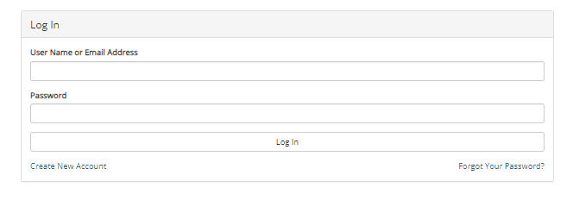
Create New Account Remember your Password!!!
USE AN EMAIL ADDRESS YOU CHECK FREQUENTLY!

Slide 9
Create Account Steps

Slide 10
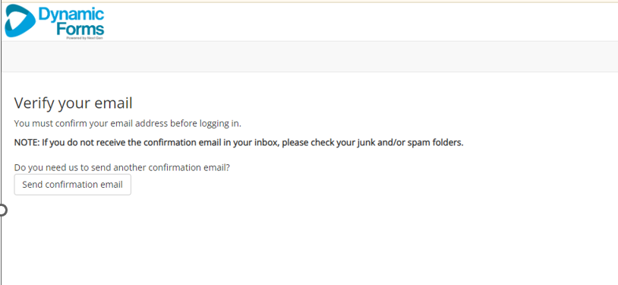
Check your email for a link to activate your account
USE AN EMAIL ADDRESS YOU CHECK FREQUENTLY!

Slide 11
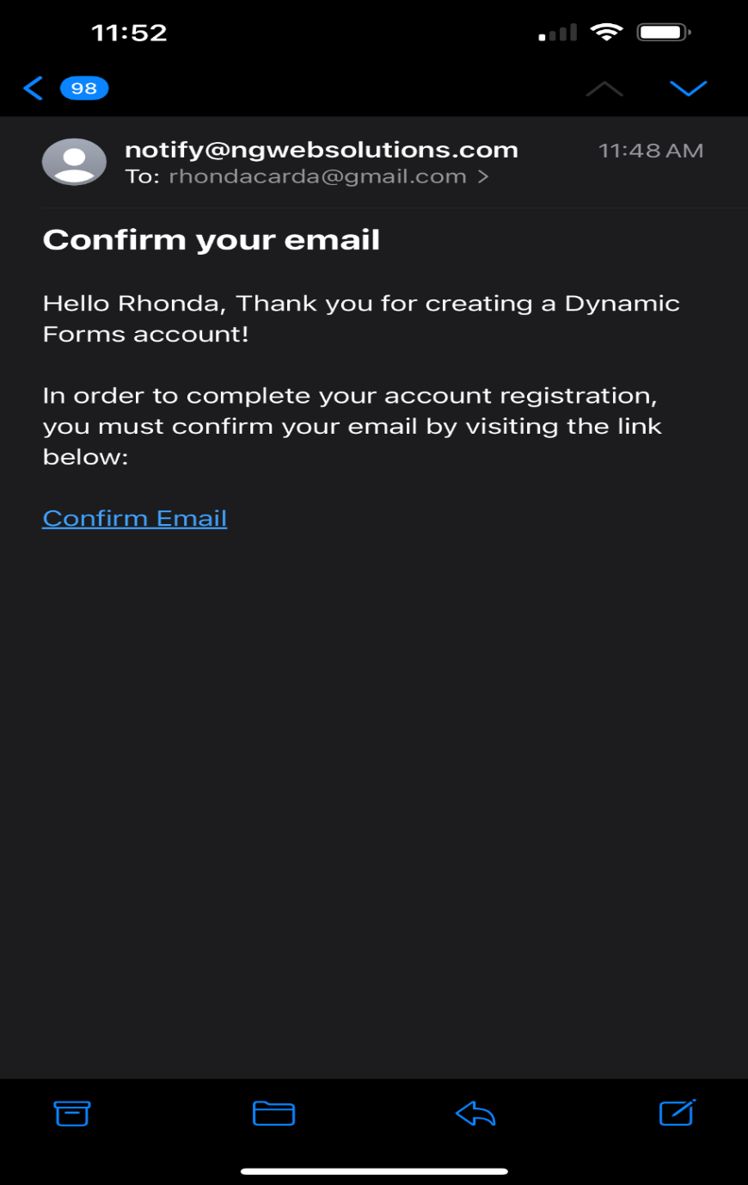
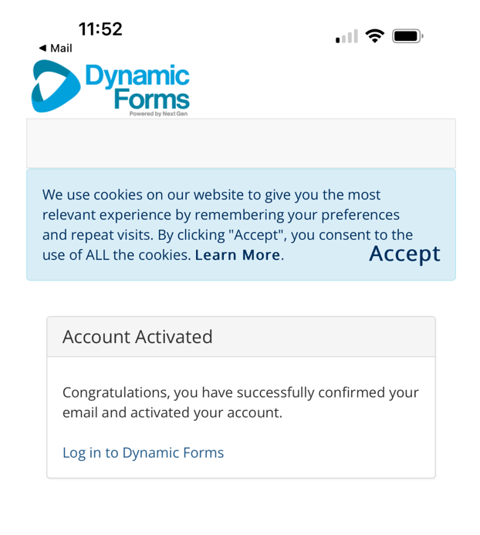
Confirm and Activate Your Email

Slide 12
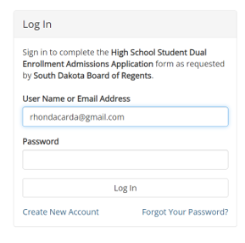
You will have to log in with your email and password

Slide 13
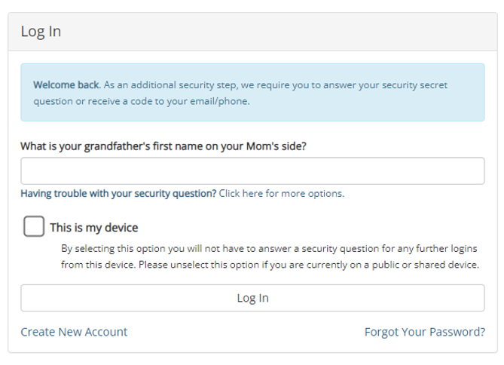
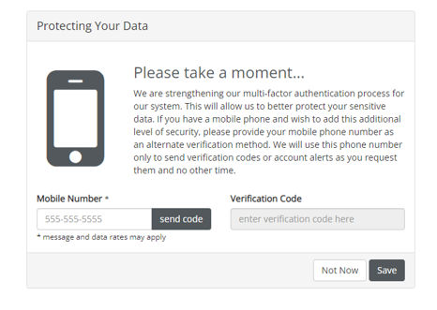
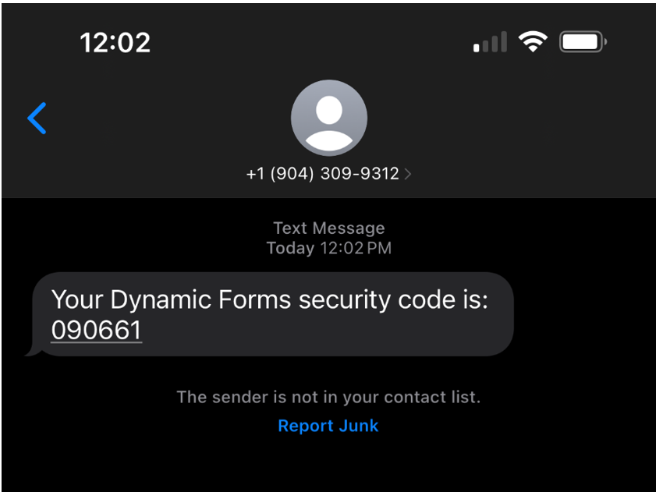
Authenticate – Security Process
1. Answer the security question you set up previously and check the box identifying your device. Click Log In.
2. Enter your cell phone number
2. Enter security code

Slide 14
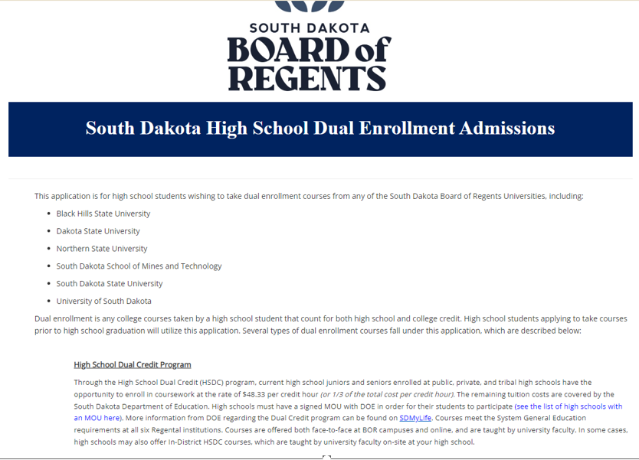
Information
dfg
The next 2 slides
Contain information regarding Dual Enrollment through the state of South Dakota.
Enter the name and email address of your high school counselor where shown.

Slide 15
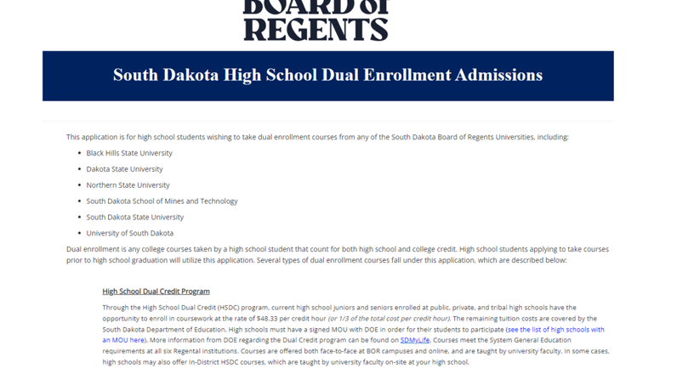
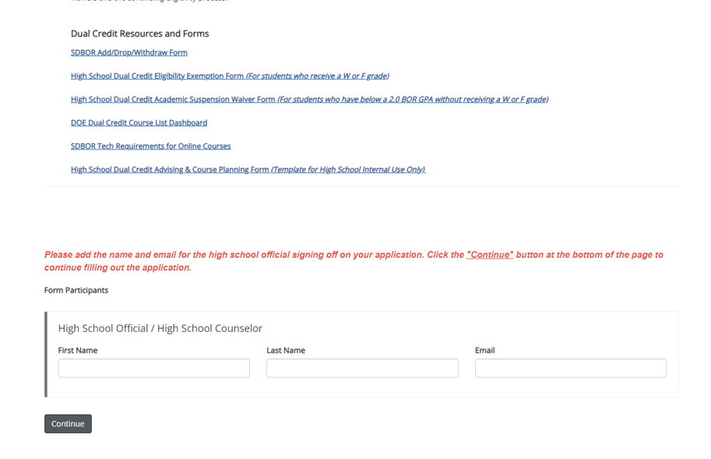
Information CONTINUED

Slide 16
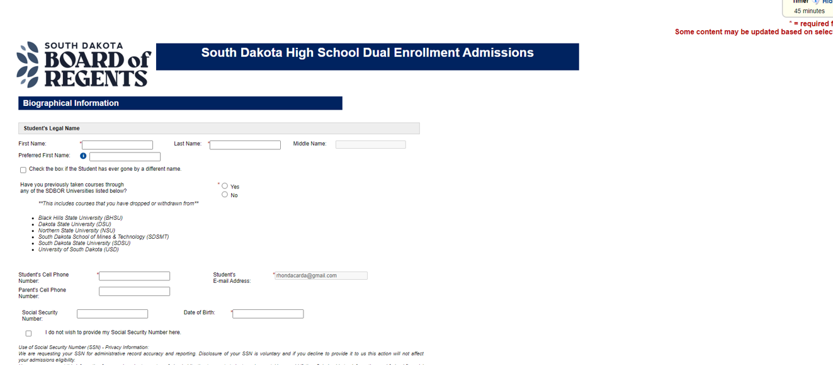
Biographical Information

Slide 17
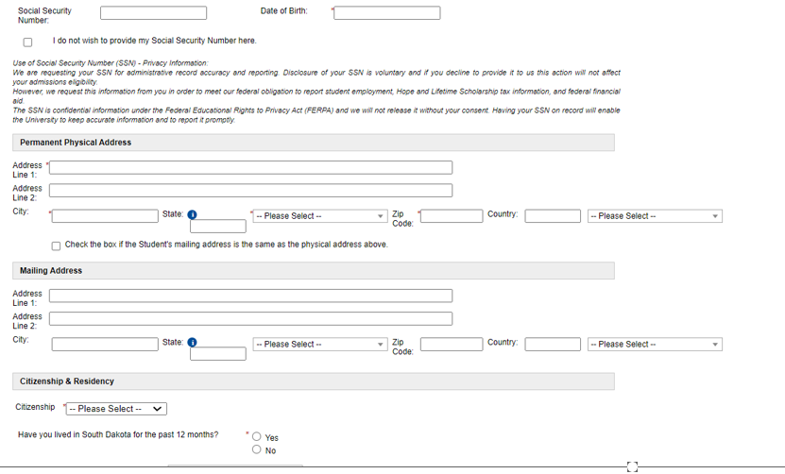
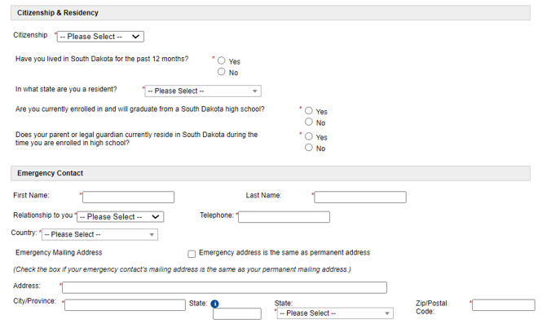
Biographical Information continued

Slide 18
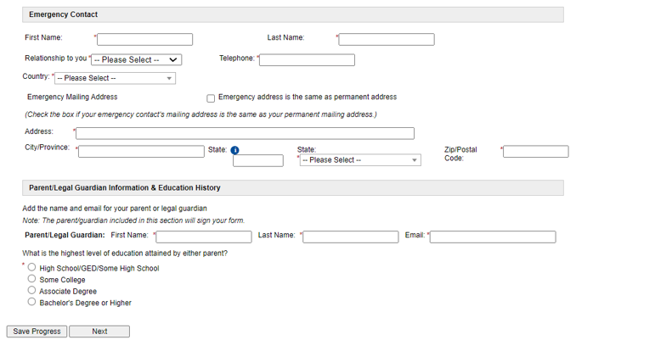
Biographical Information continued. Click Next or Save Progress
School Information. Click Next or Save Progress

Slide 19
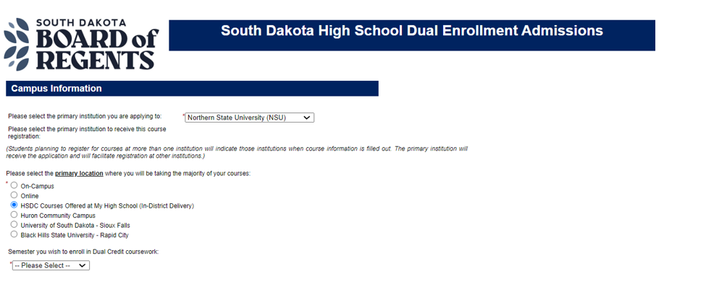
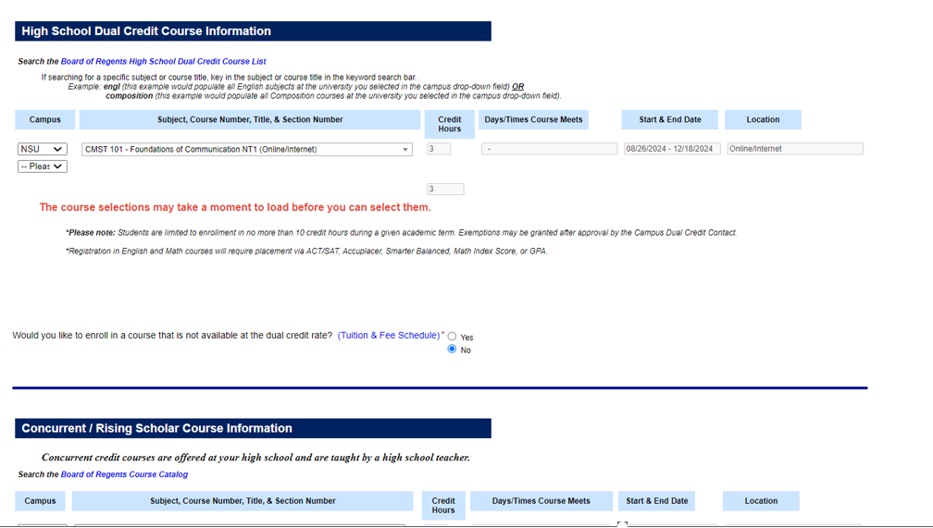
Dual Credit Information
If you are interested in an online course, fill out this section. Otherwise leave this blank.
Enroll in Rising Scholars courses offered AT YOUR HIGH SCHOOL in this space.

Slide 20
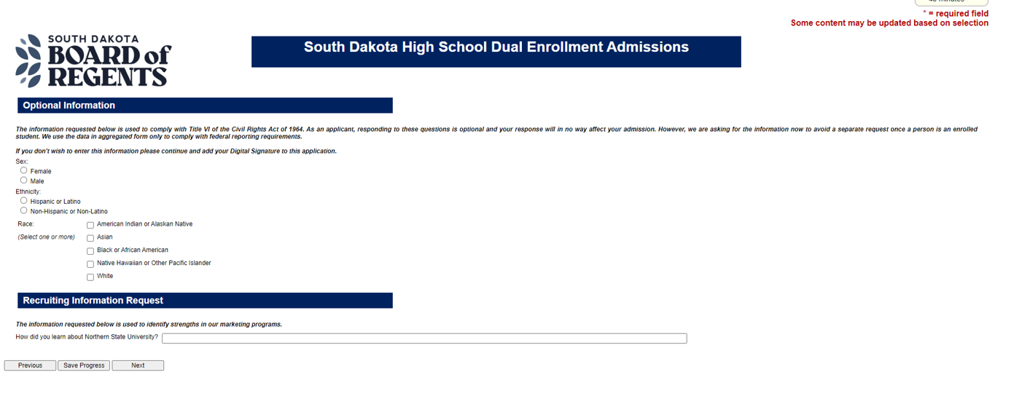
Optional Information
Click Next or Save Progress

Slide 21
Eligibility and Expectations Information

Slide 22
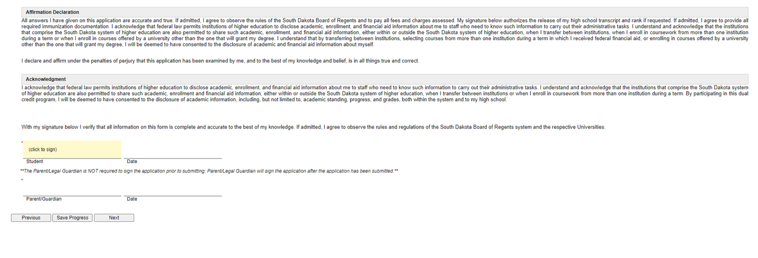
Acknowledgement Signature
Click to sign your acknowledgement of the information provided.

Slide 23
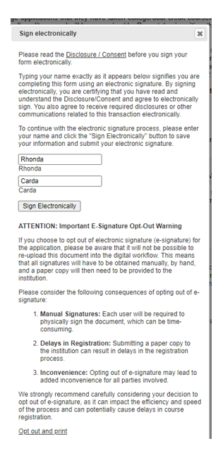
Electronic signatures
If you choose to sign manually you will need to click here.
NOT recommended.

Slide 24
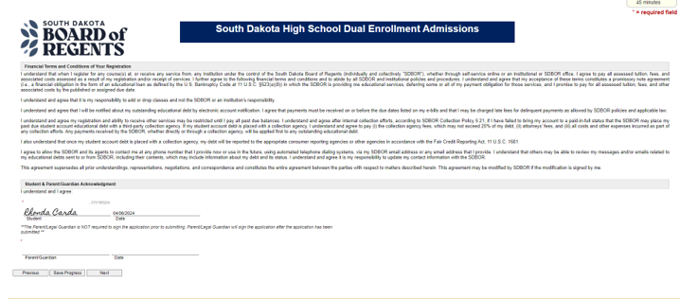
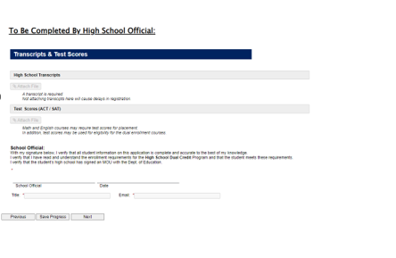
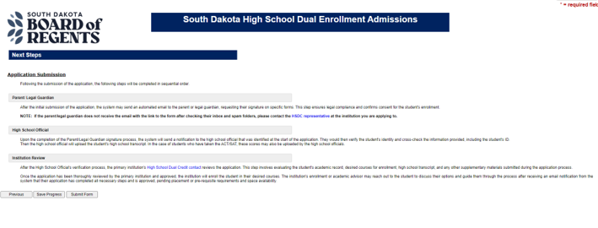
Final Process
Confirmation of your signature. This will move to the email address you provided for your parent/guardian.
After all signatures are received, the application will move to the High School for completion.
Click Submit to start this process.

Slide 25
Communicate with your parents!!!!!
Your school counselor will verify and send all test scores and transcripts.
We will wait for ACT scores to see if you qualify.
You WILL NOT have to pay at this time.
You MUST use an e-mail address you check frequently!
Register even if you do not know if you qualify or aren’t sure you want the credit. You are not fully committed to college credit until the start of the term.
There will be an additional Accuplacer testing day for those that need it.

Slide 26
Questions? Contact:
Your High School Counselor first!
Then ask Rhonda…
Rhonda Carda - Academic Advisor
for Rising Scholars
Rhonda.Carda@northern.edu 605-626-7900 (office)
Other Contacts:
Matthew Perreault - NSU Assistant Director of Admissions
Matthew.Perreault@northern.edu
Terry Piatz – Director of Rising Scholars
Terry.Piatz@northern.edu

